Slide 1



ANGEL ONE
FINANCIAL DASHBOARD
A business analytics project using Excel and Power BI
Navya Rustagi
8th July 2025

Slide 2




PROJECT OVERVIEW
To understand how financial analytics works in real business scenarios
Chose Angel One, a stockbroking company, for analysis
Goal: Build dashboards for Profit & Loss, Balance Sheet, and Cash Flow
Learn how to extract insights from financial data using Power BI

Slide 3


DATA SOURCES
Collected financial statements (P&L, Balance Sheet, Cash Flow) of Angel One from Moneycontrol.com
Extracted and cleaned the raw data manually using Excel
Calculated key financial metrics in Excel (like ratios, margins, growth %)
Imported structured data into Power BI for visualization
TOOLS USED
Excel: Data cleanup, financial metric calculation
Power BI: Dashboard creation, slicers, visual storytelling
DAX: Dynamic measures and KPI logic

Slide 4
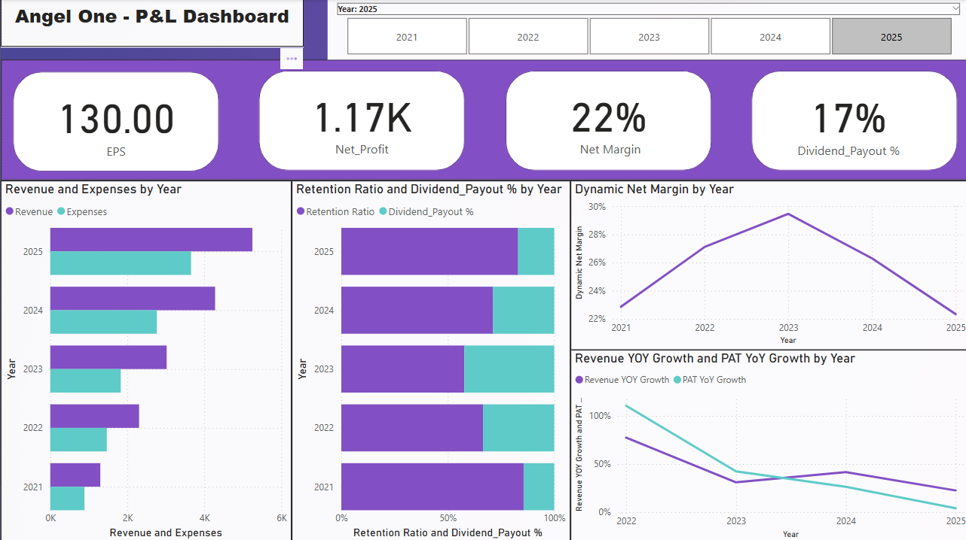
P&L DASHBOARD - VISUALS

Slide 5

P&L DASHBOARD - INSIGHTS
Key Financial Insights from P&L
Revenue consistently increased, reaching ₹5,247 Cr in FY25
Net Margin peaked at 29% in FY23, then dropped to 22%
Dividend payout declined while retention ratio rose
PAT growth slowed after FY22 despite higher revenue
EPS remained strong at ₹130 in FY25
The company shifted toward profit retention, possibly to fund internal growth.

Slide 6
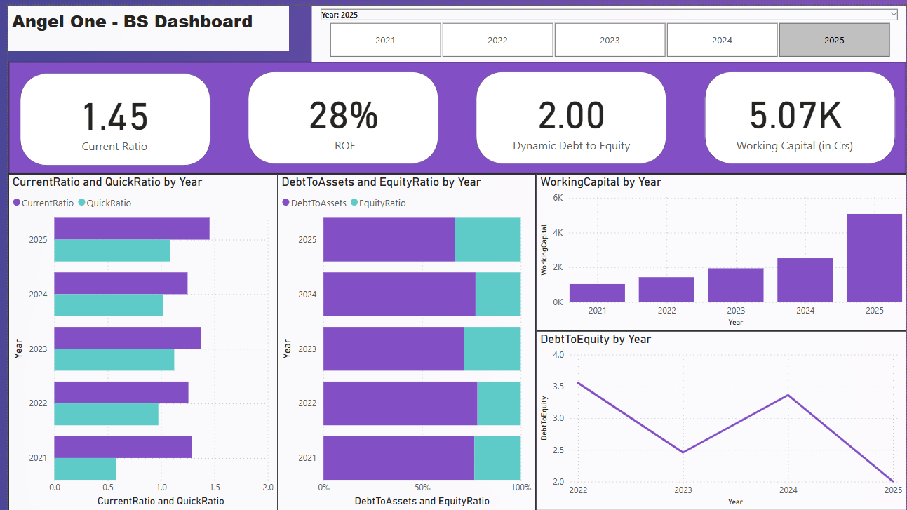
BS DASHBOARD - VISUALS

Slide 7
BS DASHBOARD - INSIGHTS
Key Financial Insights from Balance Sheet
Current Ratio improved steadily, reaching 1.45 in FY25 — strong liquidity position
Quick Ratio also improved, indicating near-term asset coverage
Working Capital increased 5x from FY21 to FY25 — good operational health
Equity Ratio rose gradually, showing stronger equity funding
Return on Equity (ROE) dropped from 55% to 28% — needs closer monitoring
The company improved its liquidity and shifted toward equity funding, but a falling ROE may indicate less efficient profit generation on shareholder capital.

Slide 8
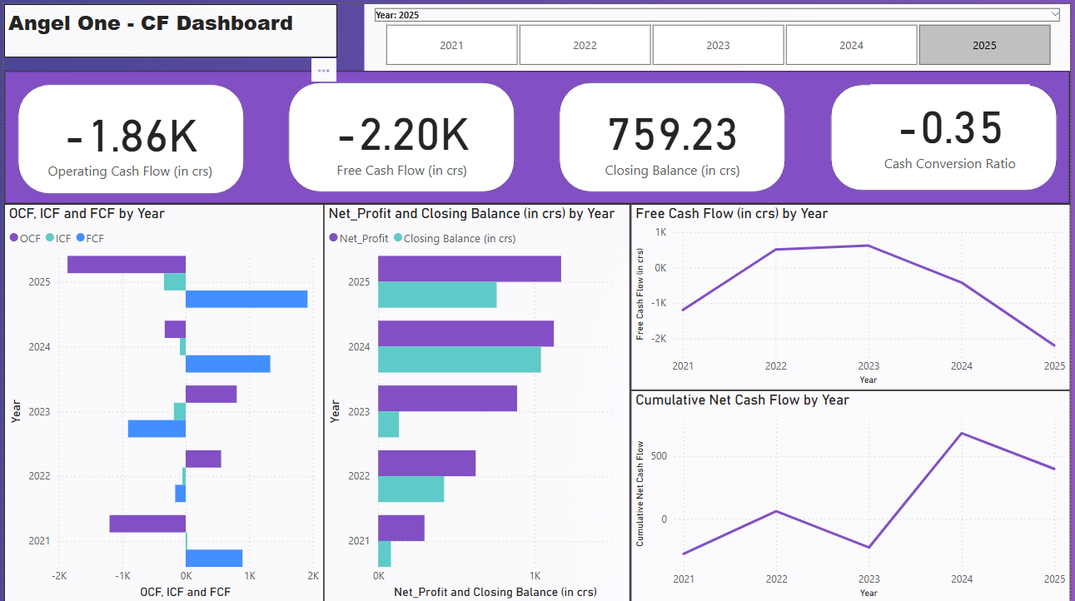
CF DASHBOARD VISUALS

Slide 9
CF DASHBOARD - INSIGHTS
Key Financial Insights from Cash Flow
Operating Cash Flow turned negative in FY25 (₹−1,860 Cr), indicating potential liquidity stress
Free Cash Flow also declined sharply after FY23, moving into negative territory
Cash Conversion Ratio dropped to -0.35 in FY25, showing low efficiency in converting profits to cash
Net Profit remained positive, but actual cash availability reduced significantly
Closing Cash Balance fell in FY25, despite earlier growth, which may signal higher spending or investment
While Angel One maintained profitability, the negative cash flow trends in FY25 may point to growing financial pressure or an aggressive reinvestment strategy that affected liquidity.

Slide 10
SUMMARY OF BUSINESS INSIGHTS
Strenghts | Observations and Risks
Strong revenue growth especially in FY22 | Operating and Free Cash Flow turned negative in FY25
Healthy liquidity position | ROE declined from 55% to 28% in 5 years
Low and declining Debt to Equity Ratio | Increased reinvestment maybe strianing liquidity
Angel One has shown strong financial growth with improving capital structure and profitability. However, the decline in ROE and negative cash flow in FY25 suggest a need to monitor reinvestment impact and operational cash efficiency more closely.

Slide 11

WHAT I LEARNED
Understood how to read and interpret Profit & Loss, Balance Sheet, and Cash Flow statements
Learned how to clean, structure, and calculate financial metrics using Excel
Built interactive dashboards in Power BI with slicers and dynamic visuals
Developed the ability to convert financial data into actionable business insights
Gained confidence in presenting data visually and analytically
This project gave me a hands-on understanding of financial analysis and dashboarding, and helped me think like a business analyst even as a fresher.

Slide 12
THANK YOU
Thank you for reviewing my Business Analytics project.
I’m excited to apply these skills in a real-world environment.
Navya Rustagi
Aspiring Business Analyst
rustaginavya13@gmail.com

